Slide 1
Algorithms for Updating Dynamic Networks
Presented by
Sriram Srinivasan
sriramsrinivas@unomaha.edu
github.com/SriramSrinivas/SriramDissertation

Slide 2
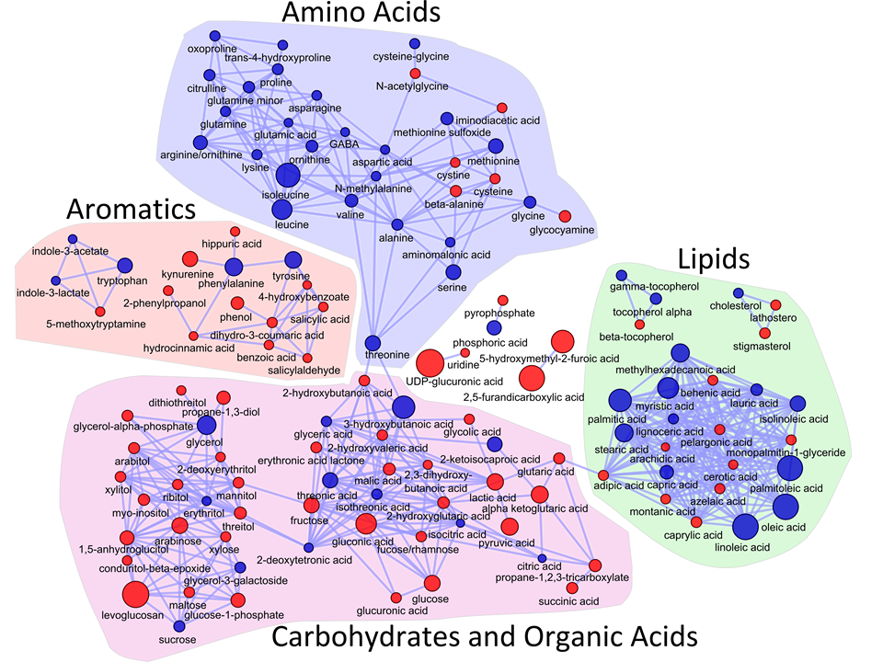
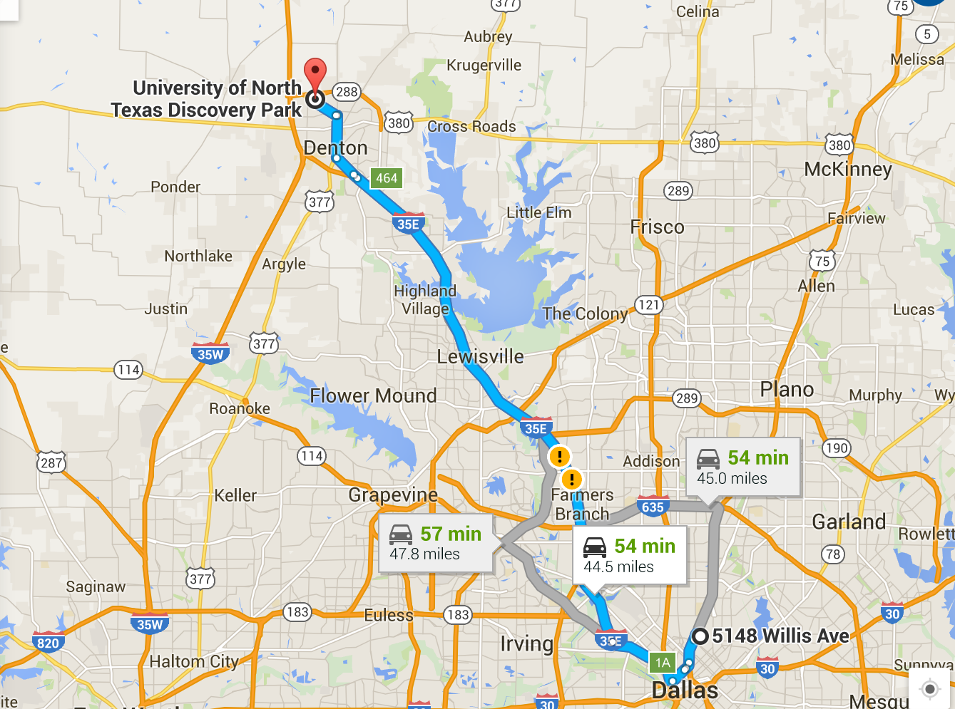

Networks
Networks (graphs) are used to model interaction among entities

Slide 3
Dynamic Networks
Analyzing properties of the networks can help in understanding the characteristics of the underlying systems
Communities indicate groups of friends in social networks
High centrality vertices indicate in important proteins in PPI networks
Networks can evolve with time, so the properties of the dynamic networks have to be updated
Goal: Update only the part of the network affected by the change, rather than recomputing from scratch

Slide 4
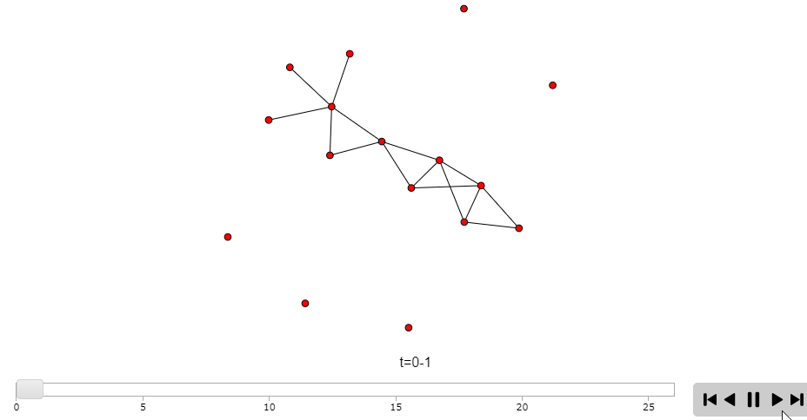
Dynamic Networks Visualization
** Simulation was designed using R & d3.js (work still in progress to visualize real-world dynamic networks) **

Slide 5
Two Properties
A
1
4
2
B
C
2
Minimum Weighted Spanning Tree (MST)
Select a subset of edges from an undirected weighted graph (V,E), such that
(i) all the vertices are connected
(ii) the sum of the total edges is minimized
Single Source Shortest Path (SSSP)
Find the shortest distance of all vertices from a given source vertex
2
2
F
A
1
2
D
E
1
2
B
C
2
F
1
2
D
E
MST: Key Edges
A
1
2
B
C
2
2
F
1
D
E
SSSP: Key Edges

Slide 6
The naïve approach
Recompute from scratch
Generate new graph after updates, perform SSSP, MST again
Can we do better than recomputing from scratch?

Slide 7
Related Work
Libraries for dynamic data/graph analysis
e.g., Sandia PHISH, Georgia Tech Stinger
Dynamic graph algorithms
e.g., Ramalingam-Reps, Narvez et al.
Parallel algorithms, implementations for SSSP in static graphs
e.g., Delta-stepping, DSMR

Slide 8
Assume batched updates
Consider a sequence of insertions and deletions
Edge operations considered
Vertex insertions and deletions can be modeled by adding and deleting edges

Slide 9
Observations about graph updates
Updates may only affect a subgraph and the complete graph need not be analyzed
Not all updates affect the property updates can be processed in parallel
Not all updates affect the same subgraph affected subgraphs can be processed in parallel

Slide 10
Template for Parallel Algorithm
Sparsification
Compute only over the edges that affect the property (Key Edges)
Remaining edges accessed for deletion only
Preprocessing before input of changes
Selection
Identify the added/deleted edges that affect the property
Can be done in parallel for each edge
Edges are not yet added or deleted from the MST
Updating
Update set of key edges according to the changes
Parallel over the edges, but requires multiple iterations
Non-key edges may need to be processed

Slide 11
Updating Minimum Spanning Tree
Original Network
Sparsification
A
A
1
4
1
Change Set
A:F:1 (Ins)
A:D:4 (Ins)
D:E:1 (Del)
A:C:4 (Del)
2
2
B
B
C
C
2
2
2
F
2
F
1
1
2
2
D
E
D
E
Selection
Updating
A
1
4
1
A
4
2
1
1
B
C
2
2
2
2
B
C
F
2
2
1
2
F
D
E
D
E

Slide 12
Issues with Insertion-I
An edge A-B is inserted if there is an edge in path from A to B in the MST that had higher weight
Finding the path between (u,v) for insertion—worst case complexity O(V+E). Can occur for each insertion
Complexity of simply re-doing the MST O(ELogV)
Solution: Store the maximum weighted edges between vertex pairs. Requires O(V²) storage

Slide 13
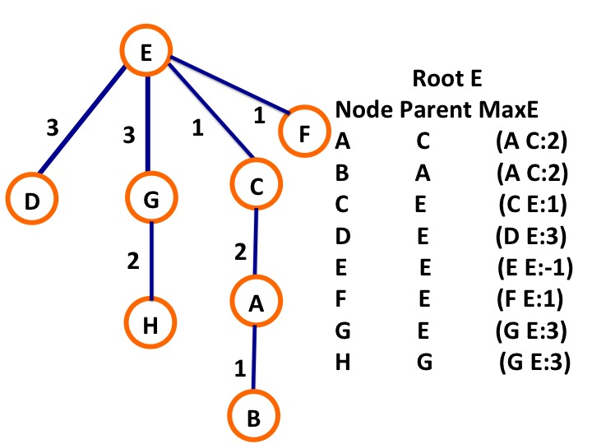
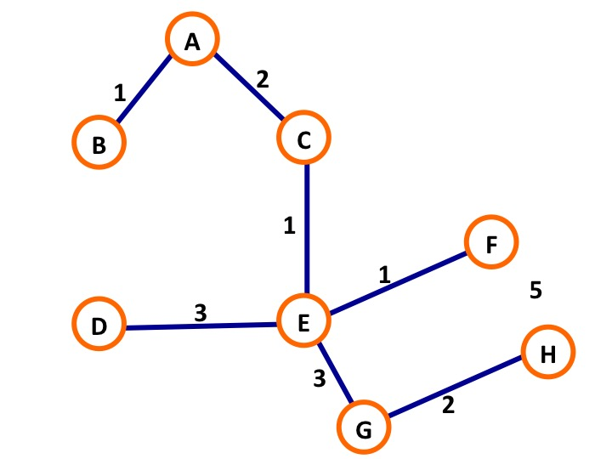
Finding Maximum Weighted Edges
Find path from a designated root to all other vertices
Mark the edges that have maximum weight in these paths
3/17/2019

Slide 14
Finding Maximum Weighted Edges
Case 1: (F:C) Max Weight Edges are Different
Max Weight from F:D (E-F) 4
Max Weight from C:D (B-D) 3
Pick the highest weight edge (E-F) 4
D
2
3
E
B
Case 2: (A:C) Max Weight Edges are Same
Max Weight from A:D (B-D) 3
Max Weight from C:D (B-D) 3
Find path from A-C and then find max weighted edge B:C 2
If we keep track of the parent, the complexity of this at most O(h);
h=height of the tree
1
2
4
F
A
C

Slide 15
Issues with Deletion
Deletion can be done in parallel by simply marking the edge as deleted
Need to reassign component id of disconnected trees to recombine them
Solution: Mark deleted edges with very high weight (INF)
Apply insertion of remaining edges—reduces to insertion problem
Keep remainder edges in buckets of increasing weight
Once tree is reconnected stop

Slide 16
Deletion and Tree Repair
Delete (D:B)
Edge D-B connecting components (D,E,F) and (A,B,C) is set to INF
Any edge connecting these two components will identify D-B as the highest weighted edge and replace it.
No need for component reassignment
Checking for highest edge will always be under Case 1
D
2
INF
E
B
1
2
4
F
A
C

Slide 17
Updating Single Source Shortest Path
Original Network
Sparsification
A
A
1
4
1
Change Set
A:F:1 (Ins)
A:D:4 (Ins)
D:B:2 (Del)
A:C:4 (Del)
2
2
B
C
2
B
C
2
2
2
F
2
F
1
2
1
D
E
D
E
Selection
Updating
A
A
1
1
1
4
1
4
2
2
2
B
C
B
C
2
2
F
F
2
1
2
D
1
E
D
E

Slide 18
Shared-memory parallelization
The Selection step is easy to implement and shows good load balance
The parallel performance of the Updating step is dependent on the number of affected vertices and the size of the subgraphs they alter. Vertex degree distributions can cause further load imbalance.
Asynchronous updates: can process longer paths instead of just neighbors. Reduce number of synchronization steps.

Slide 19
Empirical results
Results on a 36-core Intel Haswell system with 256 GB memory
OpenMP implementation
Comparison to SSSP implementation in Galois v2.2.1
Synthetic RMAT-G (skewed degree distribution) and RMAT-ER (normal degree distribution) graphs, three real-world graphs from SNAP

Slide 20
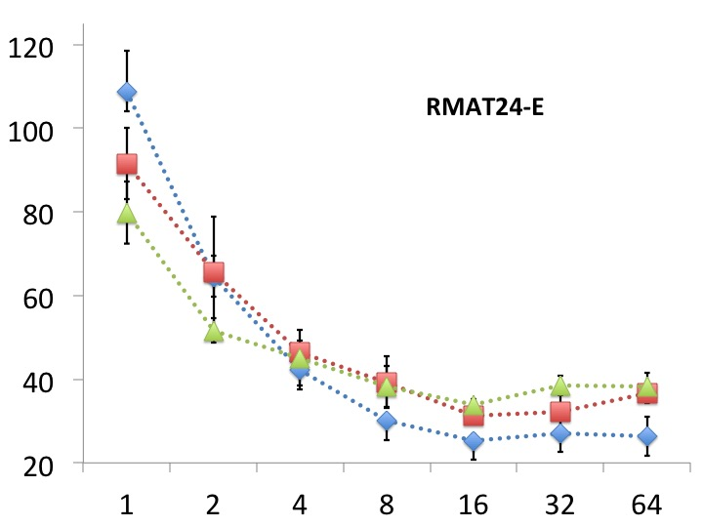
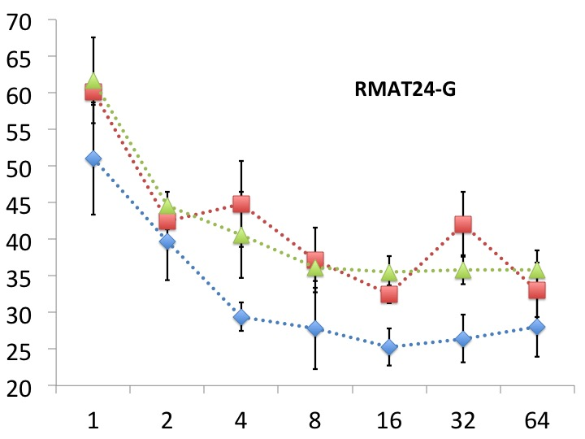
Updating MST
=100%
=100%
=75%
=50%
=75%
=50%

Slide 21
Comparison to recomputation-based approach for SSSP
New algorithm is up to 4X faster.

Slide 22
Strong scaling (synthetic graphs) for SSSP

Slide 23
Strong scaling (real-world graphs) for SSSP

Slide 24
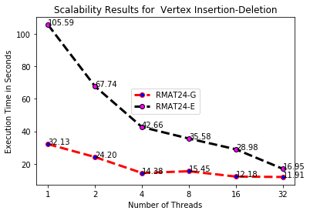
Strong scaling (vertex insertion/deletion)

Slide 25
Performance and Scalability
Updating algorithm faster than recomputing for lower number of threads
Recomputing algorithm more scalable
Reasons for low scalability
Scalability deteriorates at the update phase
Synchronization between threads updating overlapping subgraphs
The set of changed edges not known a-priori to identify these overlaps
In contrast, recomputing algorithms have knowledge of the entire graph

Slide 26
Correctness proof
SSSP :-
Lemma:- Tree obtained by the proposed approach will be a valid SSSP tree for the updated Graph G.
MST :-
Lemma:- After updating MST, sum of edge weights of the updated graph is equal to the sum of the weights of the active key edges in the rooted tree.
Connected Components :-
Lemma:- After updating connected components, if there exists a path between two vertices u and v in updated graph, there also exist a path between those two vertices in the updated rooted tree.
(Complete proof please check dissertation *)

Slide 27
Applications of dynamic SSSP?
Many applications
Maps and GPS
Internet routing
Path planning for robots
Discrete event simulations
Centrality analysis in complex networks

Slide 28
Contributions to Date
A new two-step parallel algorithm for updating the SSSP, MST & Connected Components
optimizations to improve scalability
optimizations to reduce redundant/wasteful computation
Correctness proof
Empirical evaluation to demonstrate speedup over recomputing SSSP & MST from scratch

Slide 29
Research Questions
How to improve scalability of updating
Hybrid: move to recomputing once the edges that affect the property are known
Asynchrony: increase length of asynchrony during updating
Hot Spots: identify subgraphs that will be most affected by change, store them separately
Scheduling Changes: if changes are known, can we schedule them for improved performance
How to measure scalability of updating
Time: fundamental measure, but affected more by type and amount of changes than size of graph
TEPS: traversed edges per second, but we are trying to reduce the number of edges traversed
Others: number of edges updated per change

Slide 30



Timeline
Brainstorming on how to analyze dynamic networks
Brainstorming on how to update MSTand SSSP.
Solved SSSP, SC18(Accepted @ HIPC 18)
August 2015
June 2016
Dec 2016
May 2017
March 2018
Solved Connected Components. Presented in IPDPS 2016
Solved MST, Presented in SIAM CS17, and IPDPS (Ph.D.forum) 2017. IEEE Transactions on Big data Journal (Accepted @ 06/2018)

Slide 31
Research Plan- (Task 1, Updating Strongly Connected Components (SCC))
Definition:- Group of vertices in a directed network such that there is a path between all pairs of vertices
Research problem :- Update SCC as network changes i.e. Dynamic Networks
Proposal:- Extend the shared memory implementation of updating SSSP & MST to SCC

Slide 32

Research Plan- (Task 2, Extending to GPUs)
Research problem :- Shared memory implementations of updating SSSP, & MST on dynamic networks show limited scalability as thread count increases. GPUs can be a good candidate for updating the network properties to achieve better scalability
Proposal :-Implement GPU version of updating SSSP on dynamic networks

Slide 33
Research Plan- (Task 3, Shared Memory Implementation of Overlapping Communities)
Definition:- Group of vertices which are strongly connected internally and sparsely connected externally
Research problem :- Scalable implementation of algorithm to detect overlapping communities and measure the quality
Proposal:- Implement shared memory approach for GenPerm

Slide 34
Research Plan- (Task 4, Implementing a shared memory hybrid-Chordal filter)
Research problem :- Networks are generally loaded with noise, which results in signal corruption. Network filters can reduce noise and size while preserving the significant network structure
Proposal :- Previous work**sequential hybrid filter showed great results, implementing a multithreaded hybrid-chordal filter can improve performance
** K. Dempsey, T. Chen, S. Srinivasan, S. Bhowmick and H. Ali, "A structure-preserving hybrid-chordal filter for sampling in correlation networks," 2013 International Conference on High Performance Computing & Simulation (HPCS), Helsinki, 2013, pp. 243-250. **

Slide 35
Timeline for Proposed Dissertation Research Plan
Update dissertation with the outcomes of all the proposed research, and complete final dissertation exit requirements
Implement shared memory implementation of Updating SCC
Implement shared/distributed Memory Implementation of Overlapping Communities
August 2019
December 2019
Jan 2020
April 2020
October 2020
Compare results for SCC with other state of the art SCC implementation
Performance comparison with other Overlapping Community Detection algorithm and Start working on GPUs & Hybrid-Chordal filter

Slide 36
Conclusions
New shared-memory algorithm for updating SSSP & MST in dynamic networks
Performance results demonstrate up to a 4X performance improvement over a parallel recomputation-based SSSP code
Plan to extend the general approach to update SCC
Future GPU and distributed-memory implementations

Slide 37



Acknowledgments & Collaborators
Dr. Boyana Norris,
University of Oregon
Dr. Sajal Das,
Missouri S&T

Slide 38

Thank you!
Questions?
Corresponding author: Sriram Srinivasan, sriramsrinivas@unomaha.edu
github.com/SriramSrinivas/SriramDissertation

